Slide 1
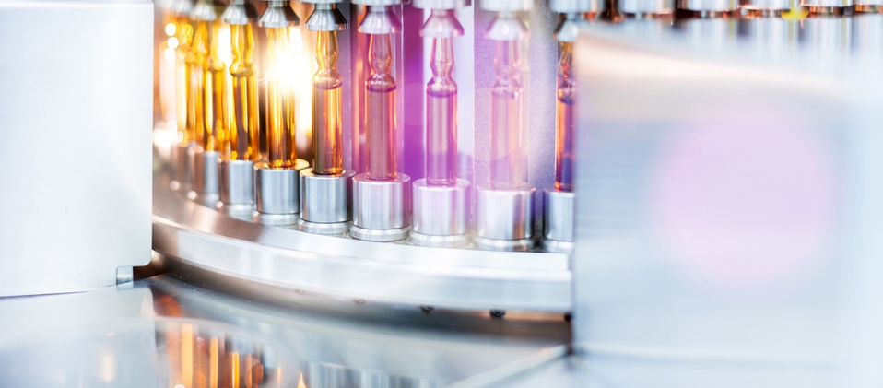
Pharmaceutical,
life sciences, and medical devices sectors in Mexico
July 2021

Slide 2
The enterprises from the Mexican pharmaceutical industry are bigger than average among manufacturing industries.
An enterprise from the pharma industry has an average of 116.1 jobs, the manufacturing industries have an average of 9.8. At a national level, there are 4.4 jobs per economic unit.
The enterprises that conform the pharma industry employed 83,336 people and represented 1.6% of the manufacturing industry occupation. in 2014.
The pharma industry contributed with an average of 4.1% to the manufacturing GDP from 1993 to 2014.
Importance of the pharma industry GDP in the manufacturing GDP Percentages regarding the manufacturing industry
Occupied personnel in the pharma industry
80,921
83,336
61,851
2004
2009
2014
Fuente: INEGI. Censos económicos 2004, 2009 y 2014
Fuente: INEGI. Sistema de cuentas nacionales de México

Slide 3
The main supplies that the pharma industry demands come from the manufacture of basic chemical factories and from the pharma industry itself, both activities concentrate 62.7% of the total supplies.
The pharma industry, in addition to require raw materials, also demands services such as business administration, payroll, accounting and audit, among others.
From the total needed supplies for the pharma industry, more than half are imported (55.2%),
The production of the pharma industry is mainly destined to satisfy the final demand (75.2%) constituted by internal consumption and exports and the rest (24.8%) covers intermediate demand.
Pharma industry production destination
Percentage regarding production value
Pharma industry
Production value components
Percentage regarding production value
Total of supplies 46.7
53.3
23.3
23.3
Domestic
Imported
Gross value added
Fuente: INEGI. Elaboración con base en la Matriz de Insumo-Producto, 2012
Fuente: INEGI. Sistema de cuentas nacionales de México, Matriz de Insumo-Producto, 2012

Slide 4
The production of the pharma industry is concentrated in Mexico City, the State of Mexico and Jalisco, jointly represent 84.1% of the total production and 80.5% of the occupied personnel.
From a total of 718 pharma industry companies, 222 are in Mexico City.
Antibiotics are the most important products of the pharma industry (14.8% of the total production value and 22.3% of the total volume) in 2014. They are followed by medicines for the digestive system and metabolism.
Volume and value of pharma products, 2014
<<<
Pharma products | Value | Volume
 | Percentages | Porcentajes
Total | 100.0 | 100.0
Antibiotics | 14.8 | 22.3
Medicines for the digestive system and metabolism | 13.2 | 24.9
Medicines for the cardiovascular system | 8.9 | 6.8
Medicines for the nervious system | 8.8 | 5.9
Medicines for the respiratory system | 7.4 | 6.3
Vitamins and vitamin compounds | 6.6 | 5.8
Medicines for veterinary use | 6.0 | 3.5
Analgesics | 4.1 | 9.0
Medicines for the locomotor system | 3.6 | 4.3
Supplements and food supplements | 3.5 | 5.7
Dermatological medicines | 3.1 | 3.6
Medicines for the hematopoietic system | 2.5 | 1.6
Antiparisitics | 1.4 | 3.2
Vaccines | 0.9 | 0.2
Antivirals | 0.9 | 0.7
Oncologicals | 0.7 | 0.7
O | 13.6 | 5.5
Pharma industry production by state
Percentages
Fuente: INEGI. Censos económicos, 2014
Fuente: INEGI. Encuesta mensual de la industria manufacturera (EMIM)

Slide 5
Between 2009 and 2018, Mexico had a growing trade balance surplus in pharma goods, which indicates that this industry is key to Mexico.
Between 2008 and 2018, the inflows of FDI were of USD $30,740.9 million in average, less than the outflows of FDI (an average of USD $9,752.5 million in the same period.)
Every dollar invested in Mexico, generates an economic spillover of 1.64 dollars.
Mexico ranks #21 in clinical research. Every job in clinical research, generates 4.4 indirect jobs.
Total FDI inflow/outflow in Mexico (2008 – 2018, m USD)
Fuente: World Bank. 2008–2018

Slide 6
Pharmaceutical products
The pharmaceutical products exports and active principles (supplies for the pharma industry) were USD $2,429 millions in 2014, from which USD $582 millions correspond to active principles.
82.7% of the Mexican pharmaceutical products exports were destined to 12 countries in 2014.
Pharmaceutical products
Main export destination countries, 2014
Percentages
Exports of pharmaceutical products and active principles
(Million USD)
Pharmaceutical products and Active Principles
Pharmaceutical products
Active principles
Fuente: SAT, SE, BANXICO, INEGI. Balanza Comercial de Mercancias de México. SNIEG. Información de Interés Nacional
Fuente: SAT, SE, BANXICO, INEGI. Balanza Comercial de Mercancias de México. SNIEG. Información de Interés Nacional

Slide 7
Pharmaceutical products
Mexican exports represented 0.4% of the world pharmaceutical products exports, ranking #24.
The top pharma products exporting countries are Germany, Switzerland, Belgium, United States and France.
Germany, in addition of being the world top exporting country, is situated as the second country (after the United States) from which Mexico imported more pharma products.
Pharmaceutical products
World main exporting countries, 2014
(%)
Fuente: International Trade Center

Slide 8
78.2% of the pharma products were imported from 9 countries in 2014, the more important being United States, including Puerto Rico, Germany, France and Switzerland
Pharma products imports from China are increasing by a 28.4% annual rate.
Pharmaceutical products
Main imports origin, 2014
(%)
Pharmaceutical products
Mexican imports from China, several years
Million USD
Fuente: SAT, SE, BANXICO, INEGI. Balanza Comercial de Mercancias de México. SNIEG. Información de Interés Nacional
Fuente: SAT, SE, BANXICO, INEGI. Balanza Comercial de Mercancias de México. SNIEG. Información de Interés Nacional

Slide 9
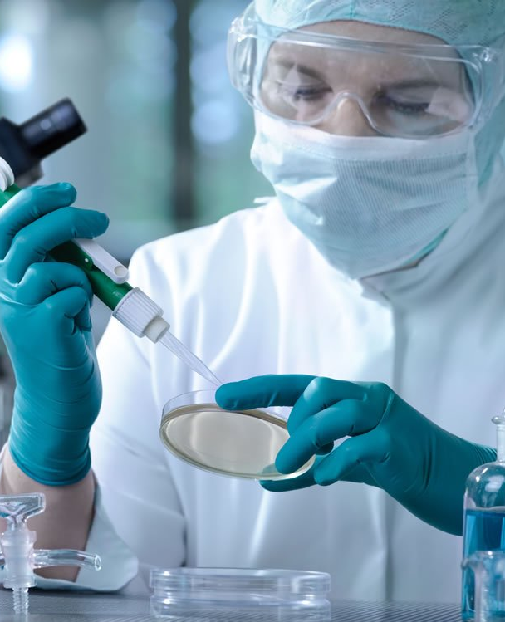
Mexico is the second largest market in Latin America in the pharmaceutical industry, and it is an important producer of high-tech medicines, including antibiotics, anti-inflammatories, treatments against cancer, among others. Likewise, 14 out of the 15 main international enterprises are situated in Mexico, for which the country has positioned itself as one of the main manufacturing centers worldwide.
In Mexico, health expenditure represents 5.4% of the GDP (in Canada is 10.4%, in Brazil 8.9%, in Chile 8.1%).
According to the National Institute of Statistics and Geography (INEGI), the pharmaceutical industry showed a growing tendency in terms of establishments dedicated to this activity, having a current record of 770 economic units.
It is predicted that in 2020 the Mexican consumption of pharmaceutical products will be of USD $26,276 millions, which represents an increase of a 100% compared to 2011.
Currently, the pharma sector generates approximately 65,204 jobs. Some of the main international enterprises from the industry are Merck, Boehringer Ingelheim, Schering Plough and Byer, among others. And nationals such as Liomont, Sanfer, Laboratorios Armstrong and Laboratorios Hormona.
Mexico is one of the most attractive markets to invest in the pharma industry due to the regulatory framework improvement and the increase in quality certifications. According to the Business Monitor, the FDA presence in Mexico has contributed to improve transparency and increase the medicine standards.

Slide 10
Pharmaceutical sales in Mexico
Mexico represents the second largest market in Latin America, just after Brazil. The pharmaceutical sales revenues has increased by a 2.9% annual growth rate from 2016 to 2020, with a value of $6.2 million USD at the end of 2020. It is expected that this sector will grow at a 4.9% annual growth rate from 2020 to 2025, reaching $8.3 million USD.
Pharmaceutical sales in Mexico
In million MXN
Fuente: SAT, SE, BANXICO, INEGI. Balanza Comercial de Mercancias de México. SNIEG. Información de Interés Nacional

Slide 11
Emerging markets with greater attraction of investments capacity in the biotech industry
90
85
80
75
70
65
60
55
50
45
40
Singapore
Taiwan
Israel
South Korea
Chile
UAE
Costa Rica
Mexico
Overall results of the 2019 Emerging Markets BCI Survey
Malaysia
Colombia
Kuwait
Argentina
Peru
Brazil
Thailand
Indonesia
Vietnam
Most likely to secure
investment
Losing out on
investment
Tier 1 (above 70%)
Tier 2 (above 60- 70%)
Tier 3 (above 50-600%)
Tier 4 (below 50%)
Fuente: 2019 Emerging Markets Biotechnology Competitiveness and Investment (BCI) Survey

Slide 12
Market | Score variaton with respect to 2017 | 2019 Score | 2017 Score
Singapore | = | 87 | 87
Taiwan |  | 80 | 77
Israel | = | 75 | 77
Korea | = | 70 | 72
Chile |  | 66 | 69
Costa Rica | = | 64 | 64
United Arab Emirates | = | 64 | 65
Mexico | = | 63 | 63
Malaysia |  | 56 | 62
Colombia | = | 55 | 56
Kuwait | N/A | 54 | N/A
Argentina | = | 53 | 53
Peru |  | 52 | 55
Brazil |  | 52 | 55
Thailand |  | 46 | 50
Indonesia | = | 42 | 44
Vietnam | = | 42 | 44
According to the 2019 Emerging Markets Biotechnology Competitiveness and Investment (BCI) Survey, Mexico got a score of 63.
In the Latin America region, Mexico ranks #3, surpassed only by Chile and Costa Rica, and above the average regional score (58).
This survey considers 5 categories:
Scientific capacity and infrastructure.
Conditions and regulatory framework in clinical research.
Regulatory system, medicine approval, quality guarantee and pharma surveillance.
Market access and financing.
Effective intellectual property protection.
Fuente: 2019 Emerging Markets Biotechnology Competitiveness and Investment (BCI) Survey

Slide 13
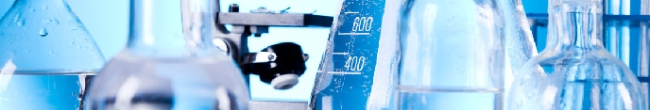
The survey also lists some factors that helps to the competitiveness of Mexico in the sector:
Stability in the conditions of clinical research.
The standards in tests and clinical procedures are satisfactory.
The initiatives to strengthen the regulatory framework in pharmaceutical surveillance have the potential to make the country more attractive to investments.
Chapter 20 of T-MEC introduced better rules for intellectual property protection, including a time frame for the protection of regulatory data of 5 years for new chemical entities and 10 years for biological.
Mexico has the needed elements to incentivize innovation in the biopharmaceutical sector:
Skilled labor force, population open to receive new treatments, strategic geographical location near the United States, and a foreign investment attraction network of agreements.
It also has developed a legal framework on intellectual property rights, a strong base on academic research and several regional innovation clusters.
Fuente: 2019 Emerging Markets Biotechnology Competitiveness and Investment (BCI) Survey

Slide 14
Research and Development (R&D)
In Mexico, most of the R&D investment is funded by the government and it is estimated that only 10-15% of private companies conduct R&D.
Private investment in R&D as a percentage of the gross domestic expenditure on R&D (GERD) in Mexico is lower that other Latin American markets and falls short of the OECD average.
Private R&D investment is focused predominantly on the motor vehicle, electrical equipment and pharmaceutical manufacturing industries.
In 2016, 55% of the revenue of innovative companies derived from products with an innovative component (versus 47% in 2010-2011).
Fuente: Charles Rivers Associates. Value of IP for Health and Growth. The economic benefits of strengthening the environment for innovation in Mexico. August 2020.

Slide 15
Main biotech clusters in Mexico
Each region promote clinical investigation clusters along with other clusters driven by foreign investment oriented, specifically, in the pharmaceutical manufacture. Baja California has developed industrial and academic potential in biotech. The city of Ensenada has R&D centers focused on areas such as marine and biotechnological science, optics, applied physics and agricultural biotech.
Life sciences companies, 2021
Argentina
30
1
Mexico
23
6
Baja California
Guanajuato
Jalisco
México
Morelos
Nuevo León
Querétaro
Chile
20
2
7
Medical Technology
Pharmaceutical Companies
Biotechnology (Others)
Biotech (R&D Services)
Biotechnology (Therapeutics and Diagnostics)
3
5
4
Fuente: Charles Rivers Associates. Value of IP for Health and Growth. The economic benefits of strengthening the environment for innovation in Mexico. August 2020.

Slide 16
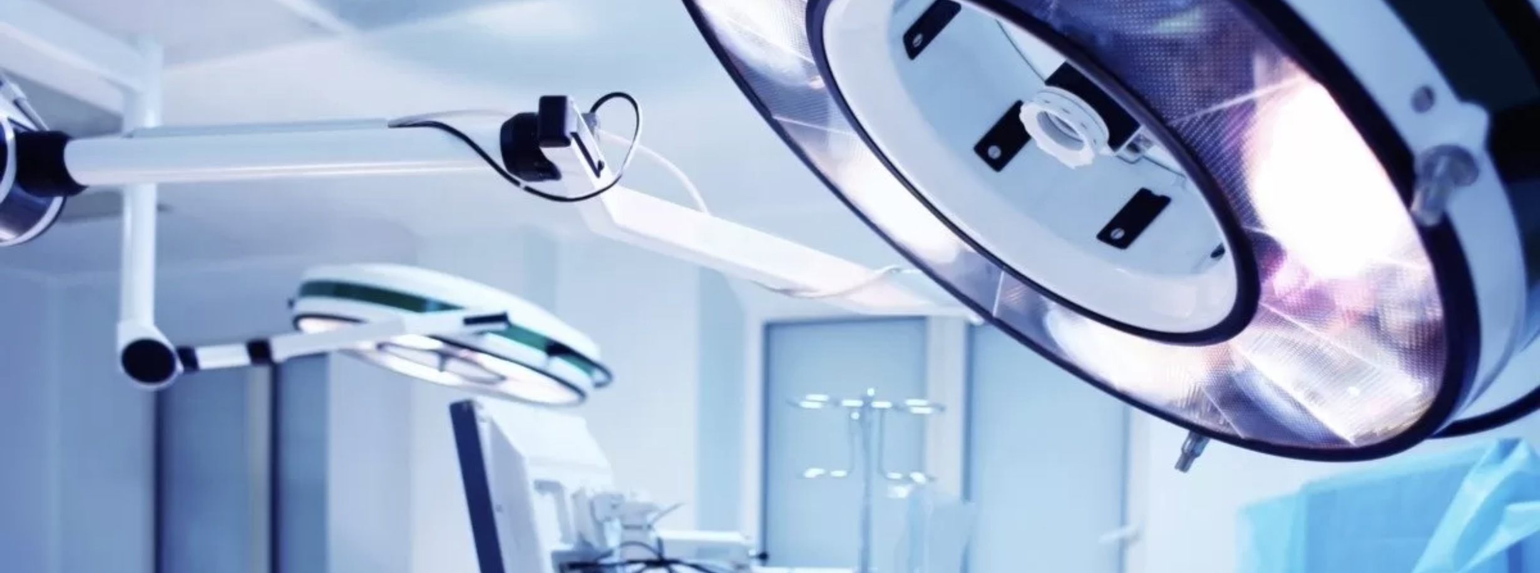
Medical device and equipment market size in Mexico
(USD billions)
 | 2017 | 2018 | 2019 | 2020 (estimated)**
Total Local Production | 14.8 | 15.5 | 13.9 | 14.7
Total Exports | 11.6 | 13.2 | 10.8 | 10.1
Total Imports | 5.4 | 5.7 | 4.9 | 5.2
Total market size* | 8.6 | 8.0 | 8.0 | 9.8
*Total market size = (total local production + imports) – exports
**Estimated based on market trends and economic forecasts. Please note these estimations could be severely impacted by the COVID-19 pandemic.
Source: Secretariat of Economy’s Tariff Information System via Internet (SIAVI).
Fuente: US International Trade Administration

Slide 17
USD $4,909 million in value, #18 worldwide
#1 in exports in Latin America, #8 worldwide
7.9%
growth rate between
2010-2017
#48 In per capita consumption worldwide
0.8% of total FDI
0.21% of the GDP value, 1.57% of the total manufacture GDP
The medical device and equipment market in Mexico represents a milestone in national and international job creation, growth, international market participation and investment
Fuente: Asociación Mexicana de Industrias Innovadoras de Dispositivos Médicos (AMID)

Slide 18
The Mexican regulatory authority, COFEPRIS, has made great efforts to contribute to the industry’s growth, both in pharmaceuticals and medical devices, such as the digitalization of procedures for the emission of sanitary registers, the promotion of scientific research, cooperation agreements with other countries, the implementation of regulations that improve competitiveness in the sector, among others.
Coupled with the economy growth and a growing per capita income, it is expected that the consumption of pharmaceutical products in Mexico will increase.
Pharmaceutical products consumption in Mexico forecast (million dollars)
15,321
16,163
17,052
17,990
18,980
20,024
5.5%
AAGR
2015
2016
2017
2018
2019
2020
Fuente: La industria farmacéutica mexicana, KPMG
Fuente: INEGI (2015). TMCA-tasa media de crecimiento anual.

Slide 19
Health tourism market in Mexico
In 2018, the estimated size of the global health tourism market was around $157.6 billion USD, $53.5 billion only in the North American region.
14 million travels of international patients a year, 7.1 million in North America in 2018.
8.4% average annual growth between 2018-2023, 12.2% in North America.
The size of the international health tourism industry in Mexico is between $8 and $8.8 billion USD, 5.6% of the global total, from which $3.9-$4.3 billion USD is domestic and $4.1-$4.5 billion USD is international.
The health tourism industry in Mexico had an average annual growth of 33.7% between 2013 and 2018. From 2019 to 2023 is expected to grow by 12.8%. It is anticipated that by 2023 reaches $10 billion USD.
Currently, 77% of the health tourists in Mexico are cross-border.
In 2013, the government of Baja California made a study with direct interviews to more than 100 health tourists in the border, who stated that their main motivations to travel to Mexico were:
Fuente: Deloitte

Slide 20
Health tourism market in Mexico
Other demand boosters for health services in Mexico are geographic convenience, low costs and travel time, and a growing retiring age population.
Most of the cross-border health tourist to Mexico come from the southern states of the United States. However, according to Google Trends, Canada, United Kingdom, India and Malaysia are the countries with the most searches for surgeries in Mexico.
In Mexico there are 7 hospitals recognized by the Joint Commission International (JCI), located in Tijuana, Mexico City, Cancun, and Cozumel. They specialize in bariatric surgery (bypass and gastric banding), general surgery (gallstones, cholecystectomy, inguinal hernia repair), plastic surgery (liposculpture and breast cosmetic surgery), imaging (PET-CT and angiography), nuclear medicine, checkups, neurology (Gamma knife), oncology, traumatology and orthopedics (hip replacement, knee and shoulder arthroscopy, spine surgery) and urology (kidney and prostate surgery), cardiology, gastroenterology, gynecology and obstetrics, dentistry, rheumatology, stem cells, to mention some.
Main health tourism clusters in Mexico
Sonora
Chihuahua
Nuevo León
Tamaulipas
Quintana Roo
Baja California
Mexico City
Jalisco
Guanajuato
Fuente: Deloitte

Slide 21
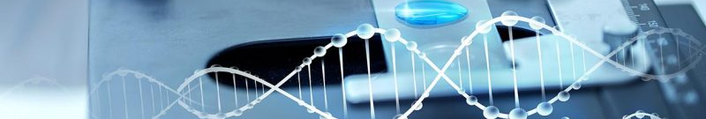
Mexico has the potential to create and nourish innovation ecosystems in health. In clinical research it has a diverse demographic profile, a health system with multiple choices to carry out research, high-level hospital infrastructure, internationally recognized researchers, and regional leadership in pharmaceutical products exports.
Fuente: AMIIF. Asociación Mexicana de Industrias de Investigación Farmacéutica, A.C.

