Slide 1
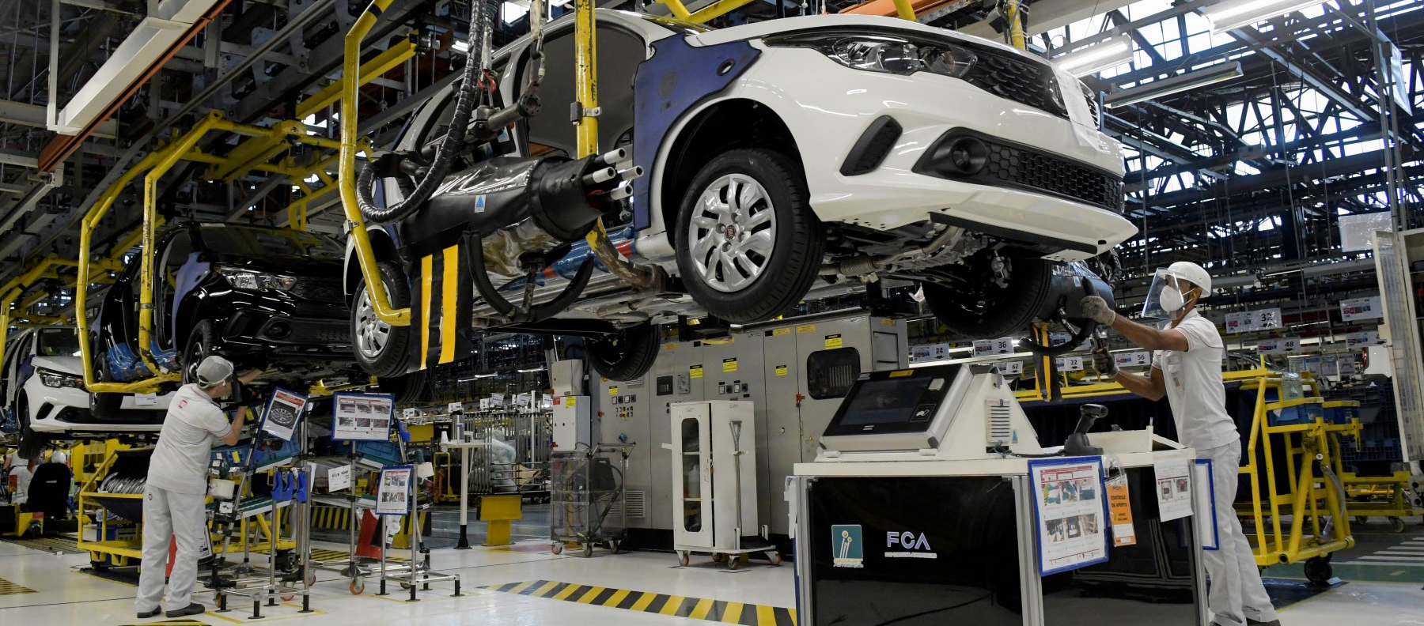
AUTOMOTIVE SECTOR IN MEXICO
June 2021

Slide 2
Automotive Industry
The total Foreign Direct Investment (FDI) received in the automotive industry from 1999 to 2020 amounts to $73,517 million.
There are 1,439 companies with FDI in this sector.
COUNTRY OF ORIGIN | FDI (million dollars) | PARTICIPATION SHARE (%) | NUMBER OF COMPANIES
USA | $38,452.8 | 48.2% | 719
Japan | $15,109.5 | 18.9% | 219
Germany | $14,087.3 | 17.7% | 200
Canada | $3,087.1 | 3.9% | 82
Korea | $2,780.3 | 3.5% | 85
TOTAL | $73,517.0 | 92.2% | 1,305
Fuente: Secretaría de Economía

Slide 3



Main companies from the top 3 countries with the highest FDI in the industry
Japan
USA
Germany
Fuente: Secretaría de Economía

Slide 4
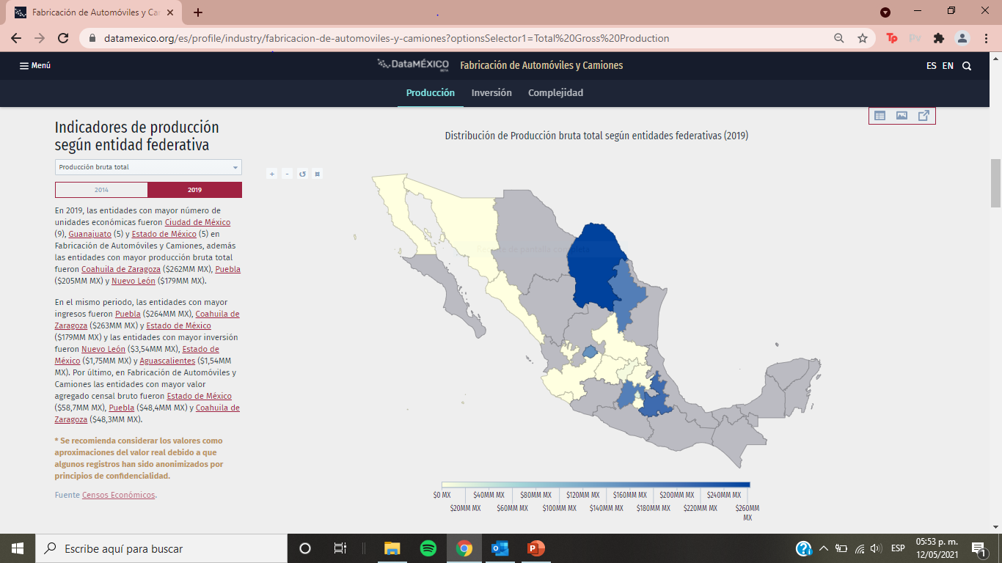
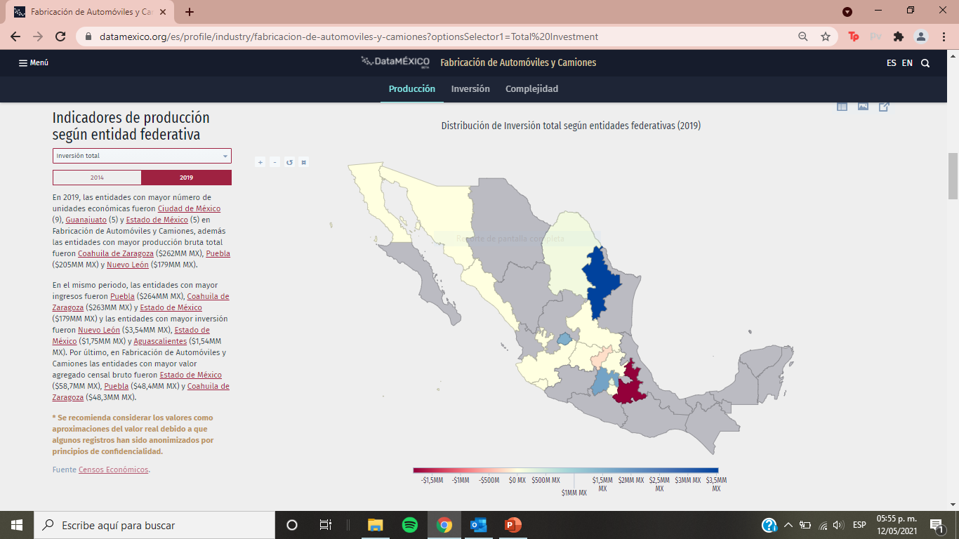
TOTAL GROSS PRODUCTION DISTRIBUTION BY STATE (2019)
TOTAL INVESTMENT DISTRIBUTION BY STATE (2019)
In the 4th trimester of 2020, the GDP registered $4 billion USD, which represented an increase of 1,92% compared to the previous trimester.
In Automobile and Truck Manufacturing, the states with the highest production were Coahuila (MX $ 262 million USD), Puebla (MX $ 205 million USD) and Nuevo León ($ 179 million USD).
In 2019 in Automobile and Truck Manufacturing, the states with the highest level of investment were Nuevo León ($ 3.54 billion USD), Estado de México ($ 1.75 billion USD) and Aguascalientes ($ 1.54 billion USD).
Fuente: Secretaría de Economía/DataMexico

Slide 5
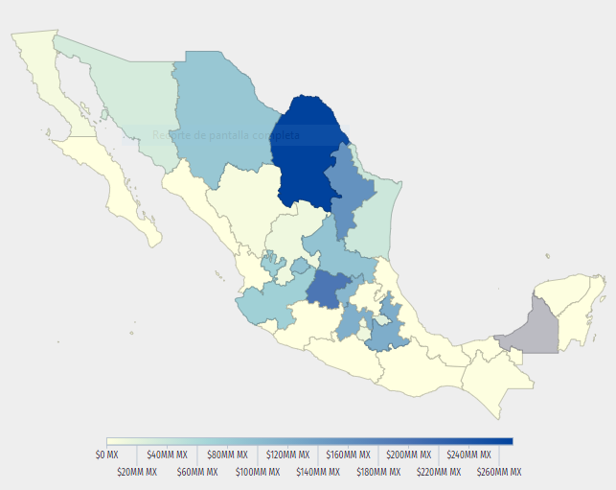
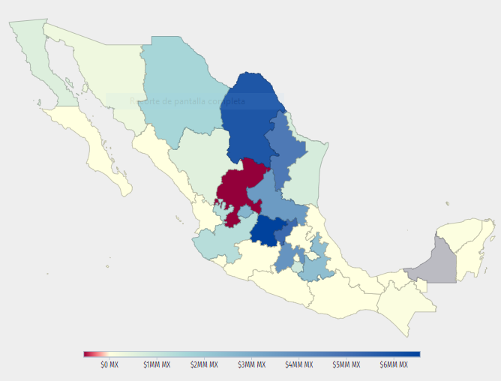
The states with the highest production were Coahuila ($ 269 million USD), Guanajuato ($ 195 million USD) and Nuevo León ($ 157 million USD). The states with the highest level of investment were Guanajuato ($ 6.56 million USD), Coahuila ($ 5.85 million USD) and Querétaro ($ 5.2 million USD).
From January 1999 to December 2020, the accumulated amount of FDI in the Manufacture of Parts for Motor Vehicles was US $ 44.7MM, distributed in accounts between companies (US $ 19.4MM), new investments (US $ 14.6MM) and reinvestment of profits (US $ 10.7 million).
TOTAL GROSS PRODUCTION DISTRIBUTION BY STATE (2019)
TOTAL INVESTMENT DISTRIBUTION BY STATE (2019)
Fuente: Secretaría de Economía/DataMexico

Slide 6
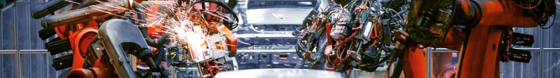
Fuente: Secretaría de Economía
According to the Political Constitution of the United Mexican States, any company, whether of national or foreign origin, may establish itself in Mexico to carry out production and / or commercialization of goods or services.
Foreign investors must observe the provisions of the Foreign Investment Law.
The establishment of production facilities for the manufacturing of vehicles and their parts does not have special requirements nor is it reserved for a specific type of investor.
The Decree to support the competitiveness of the terminal automotive industry and the development promotion of the domestic automobile market is the instrument created by the Mexican government that seeks to incentivize investments to achieve high production in the automotive industry in Mexico.

Slide 7
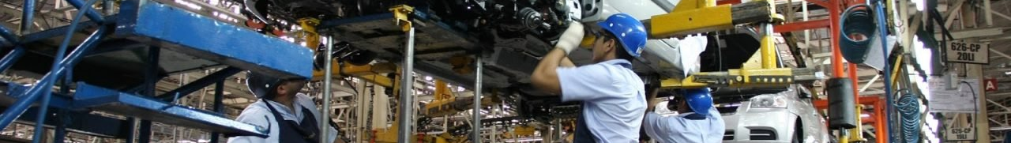
Fuente: Secretaría de Economía
Among the benefits that companies in the sector obtain by registering as production companies under the Decree, are:
  Authorization of Fiscal Deposit *
  Automatic registration for the PROSEC Sector Promotion Program. **
  To be considered as a manufacturing company under the Customs Law.
  Participation in government tenders.
  Quota to import vehicles with 0% ad-valorem tariff, equivalent to 10% of annual production and the possibility of accessing additional quotas for investments for: 1) Establishment or expansion of production facilities; 2) Human or technological development; 3) Promote purchases from national suppliers to supply plants outside the national territory.
  *Special and exclusive figure for motor vehicle manufacturers that allows them to carry out their foreign trade operations under a tax deferral scheme.
  **Instrument addressed to manufacturers to import their inputs with a preferential tariff, in order to maintain their competitiveness.

Slide 8

Regional content required to export vehicles from Mexico to other markets
The rule of origin varies depending on the Treaty or Trade Agreement.
In the case of T-MEC, vehicles manufactured in Mexico can enter the US and Canadian markets with a preferential tariff, if the value of the regional content is at least 66%, a percentage that increased to 69% in July of 2021 and 75% in 2023.
The export of vehicles manufactured in Mexico to countries with which we do not have a Trade Agreement or Treaty are subject to the MFN import tariff in force in the destination country.
In the Mexico-European Union FTA, the rule of origin for vehicles is 60%.
Fuente: Secretaría de Economía

Slide 9
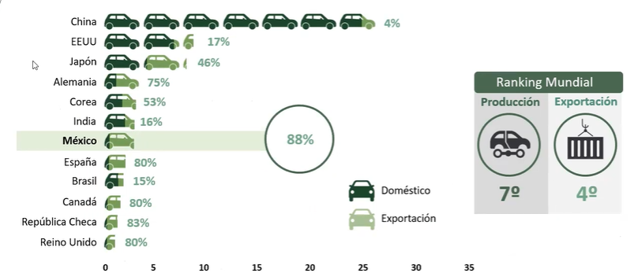
Production and export markets of light vehicles, 2020
CHINA
CHINA
UNITED STATES
JAPAN
GERMANY
MEXICO IN THE WORLD RANKING
KOREA
PRODUCER
EXPORTER
INDIA
MEXICO
SPAIN
BRAZIL
DOMESTIC
CANADA
CZECH REPUBLIC
EXPORT
UNITED KINGDOM
MILLION UNITS
Fuente: INA

Slide 10
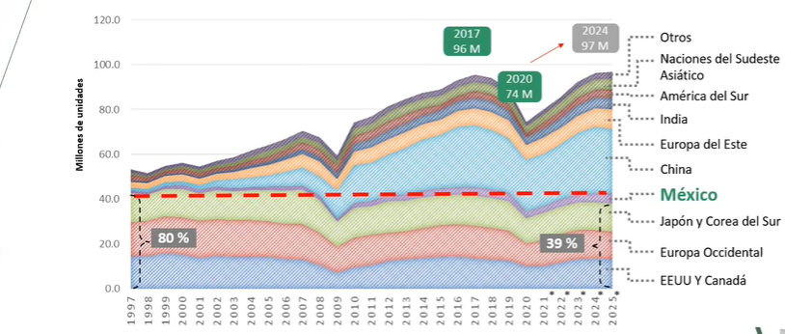
Forecast and production of light vehicles in the world, 1997-2025* *forecast
OTHERS
SOUTH EAST ASIAN NATIONS
SOUTH AMERICA
INDIA
MILLION UNITS
EASTERN EUROPE
CHINA
MEXICO
JAPAN AND SOUTH KOREA
WESTERN EUROPE
U.S. AND CANADA
Fuente: INA

Slide 11
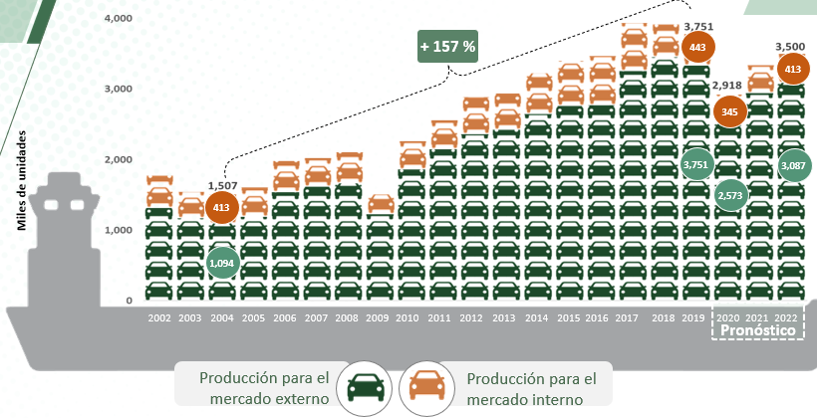
Light vehicle production in Mexico, 2002-2022
THOUSANDS OF UNITS
FORECAST
PRODUCTION FOR FOREIGN MARKETS
PRODUCTION FOR DOMESTIC MARKET
Fuente: INA

Slide 12
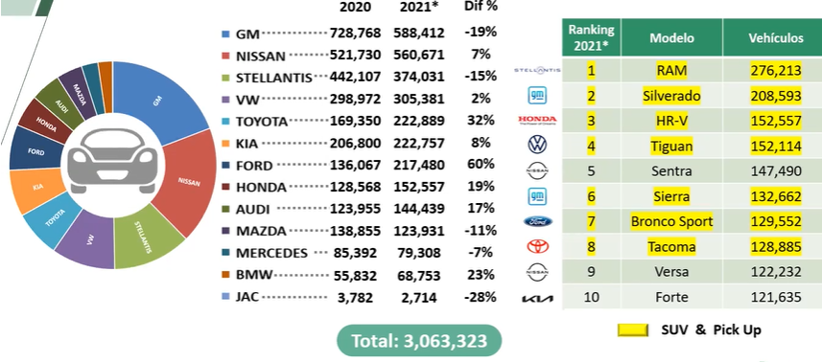
Light vehicle production in Mexico, 2020 vs 2021* *forecast
Ranking 2021*
Model
Vehicles
Fuente: INA

Slide 13










Forecast of Production of light vehicles in Mexico, 2020-2026
2020 | 687,108 | 477,226 | 433,934 | 322,356 | 130,509 | 216,741 | 156,290 | 119,683 | 119,508 | 104,169 | 62,021 | 61,552 | 21,187 | 2,912,284
2021 | 795,225 | 521,875 | 385,646 | 353,352 | 228,899 | 229,819 | 215,629 | 110,699 | 157,606 | 106,872 | 113,220 | 82,453 | 26,756 | 3,328,051
2022 | 769,390 | 474,973 | 424,695 | 363,305 | 308,352 | 254,015 | 253,659 | 116,503 | 160,152 | 128,597 | 135,537 | 77,329 | 26,471 | 3,492,978
2023 | 722,436 | 534,072 | 414,388 | 329,974 | 330,018 | 245,985 | 250,176 | 115,921 | 151,666 | 170,527 | 129,150 | 76,940 | 28,551 | 3,499,804
2024 | 654,356 | 539,361 | 468,393 | 335,087 | 324,112 | 266,888 | 389,595 | 152,401 | 158,203 | 165,868 | 124,897 | 73,651 | 34,978 | 3,687,790
2025 | 600,684 | 540,498 | 491,878 | 357,477 | 316,800 | 256,415 | 414,297 | 181,264 | 160,722 | 160,542 | 116,716 | 76,853 | 35,857 | 3,710,003
2026 | 626,969 | 599,780 | 494,370 | 373,255 | 327,384 | 245,272 | 413,510 | 204,302 | 158,090 | 157,038 | 132,971 | 70,617 | 34,811 | 3,838,369
Fuente: INA

Slide 14
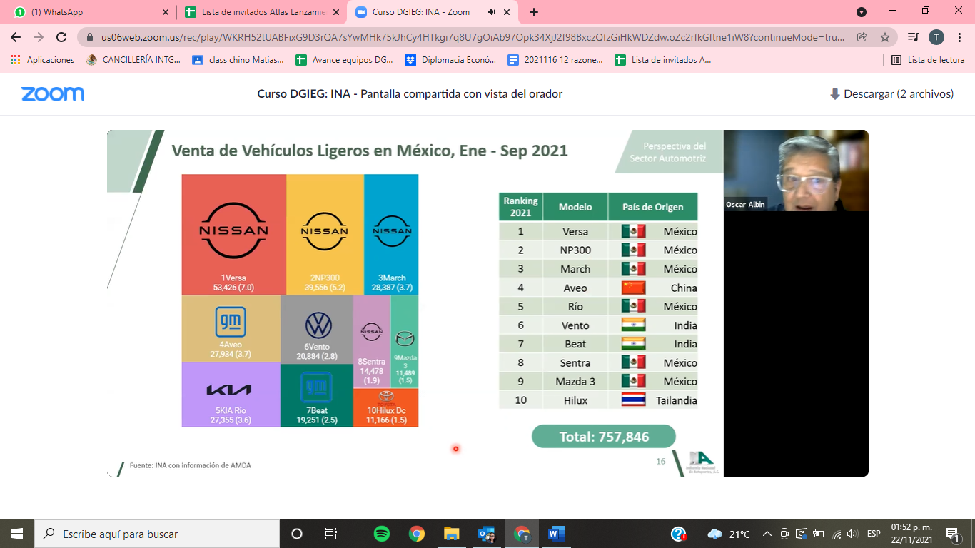



Light vehicles sales in Mexico, January-September 2021
Ranking 2021*
Model
Country of origin
Mexico
Mexico
Mexico
China
Mexico
India
India
Mexico
Mexico
Thailand
Fuente: INA

Slide 15

Manufacture operation costs, 2019, emerging countries
# | Country | Dlls/hr
1 | Czech Republic | 6.96
2 | Poland | 6.07
3 | Hungary | 5.15
4 | China | 4.79
5 | Turkey | 4.32
6 | Morocco | 4.21
7 | Mexico | 3.73
8 | Malaysia | 3.19
9 | Thailand | 2.57
10 | Tunisia | 2.26
11 | Viet Nam | 1.96
12 | Philippines | 1.83
Mexico is the 5th producer of auto parts in the world with $93 billion USD in 2021, just after China, United States, Japan and Germany; surpassing South Korea, India, Canada, Brazil, Italy and Thailand.
Fuente: INA

Slide 16
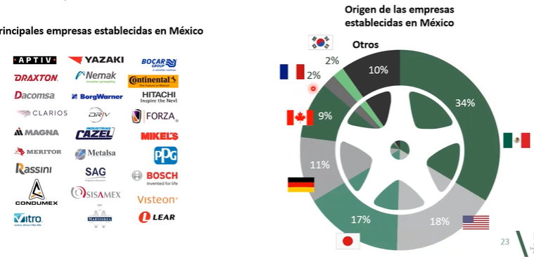
Presence of the top auto parts manufacturers in Mexico
COUNTRY OF ORIGIN OF THE ENTERPRISES STABLISHED IN MEXICO
MAIN ENTERPRISES STABLISHED IN MEXICO
Others
Fuente: INA

Slide 17
Auto parts production by State, January-July 2021 (includes motors and transmissions)

Slide 18
Mexico’s exports and imports of auto parts by country, 2021*, (million dollars) *forecast
Country | Exports | Participation (%)
United States | 64,665 | 89.1%
Canada | 2,177 | 3%
Brazil | 1,089 | 1.5%
China | 726 | 1%
Japan | 581 | 0.8%
Germany | 508 | 0.7%
Others | 2,758 | 3.8%
Total | 72,576 | 100%
Trade balance | +23,165
Country | Imports | Participation (%)
United States | 24,607 | 49.8%
China | 6,769 | 13.7%
Japan | 3,261 | 6.6%
South Korea | 2,965 | 6%
Germany | 2,471 | 5%
Canada | 1,878 | 3.8%
Others | 7,461 | 15.1%
Total | 49,411 | 100%

Slide 19
Mexico’s top exported auto parts, 2021* (million dollars) *forecast
Auto parts | 2021* | Participation (%)
Harnesses and cables | 9,037 | 11.7%
Stamped parts and body accessories | 5,254 | 6.8%
Seats and its parts | 5,252 | 6.8%
Gearboxes and its parts | 4,039 | 5.2%
Brake mechanisms | 3,283 | 4.2%
Engines and its parts | 2,951 | 3.8%
Devices for lightning or visual signaling | 2,862 | 3.7%
Devices for air conditioning | 2,720 | 3.5%
Differential axles and its parts | 2,555 | 3.3%
Air bags and seat belts | 2,459 | 3.2%
Total | 77,529 | 100%

